Slide 1

Optimal design for on-farm strip trials --- systematic or randomised
Zhanglong Cao
(Andrew Grose, Jordan Brown, Suman Rakshit)

Slide 2

OFE Cookbook

Slide 3

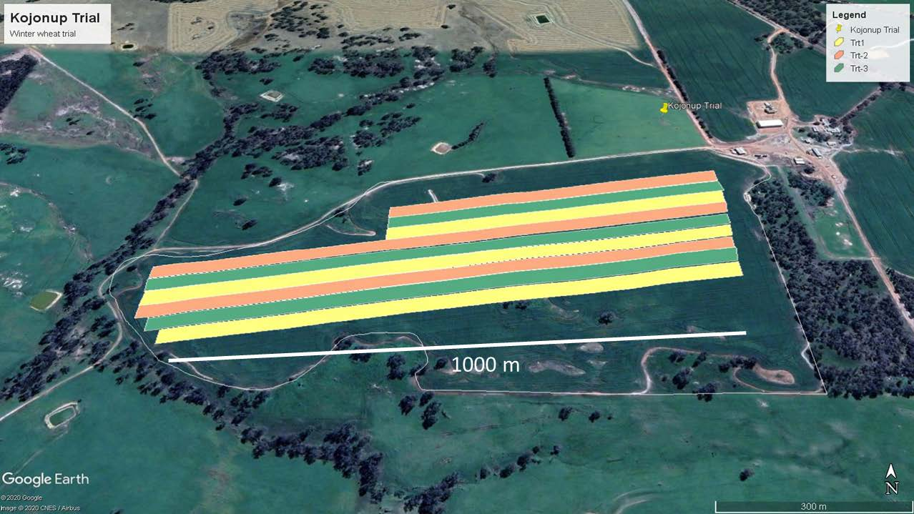
Grocery: large strip trial data
Treatments are applied to adjacent strips to detect spatial variation in treatment response.
Notes:
Why on-farm experiments?
Small plot experiments: the objective is a comparison of a set of treatments.
OFEs, in particular, site-specific crop management (SSCM):
to compare a set of qualitative or quantitative treatments, and decide on the most suitable treatment for the paddock.
to obtain a spatial map of locally-varying optimal treatments (e.g. fertiliser rates, fungicide doses).

Slide 4

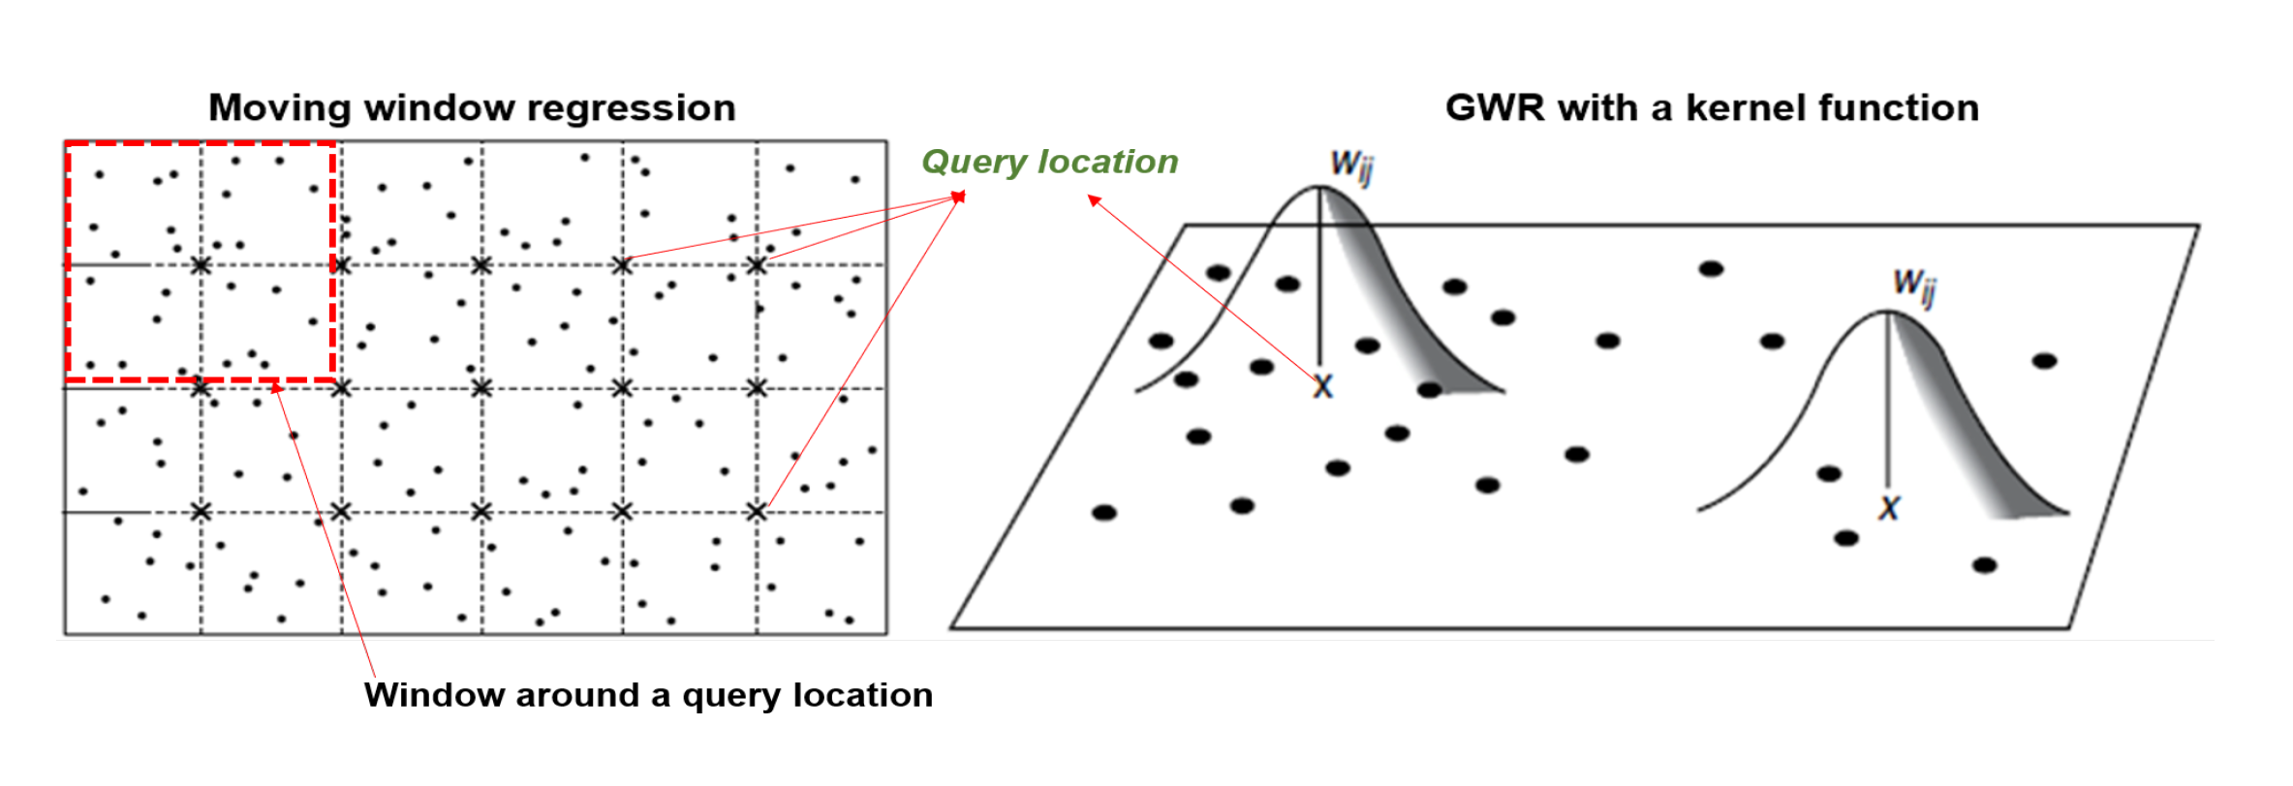
Microwave: Geographically weighted regression
For constructing the spatial map, we used GWR to compute the regression coefficients at the regular grid of points covering the study region (Rakshit et al. (2020)).
Estimation based on the local-likelihood
Estimate local regression coefficients

Slide 5



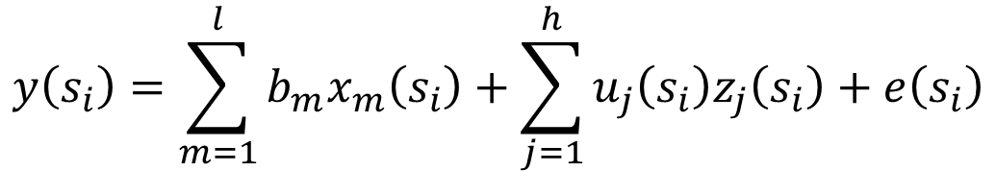
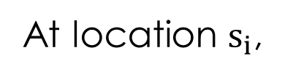


Oven: Bayesian hierarchical model
At location $s_{i}$,
$$y\left(s_{i}\right)=\sum_{m=1}^{l}{b_{m}x_{m}\left(s_{i}\right)}+\sum_{j=1}^{h}{u_{j}\left(s_{i}\right)z_{j}\left(s_{i}\right)}+e\left(s_{i}\right)$$
$$u_{i}∣θ_{u}∼𝒩(0,V_{u}\left(θ_{u})\right)$$
$$e\left(s_{i}\right)∣σ_{e}∼𝒩(0,σ_{e})$$
Hence, with $Σ_{u}=V_{s}⊗V_{u}$, we have
$$Y∼𝒩(Xb+Zu,e)$$

Slide 6

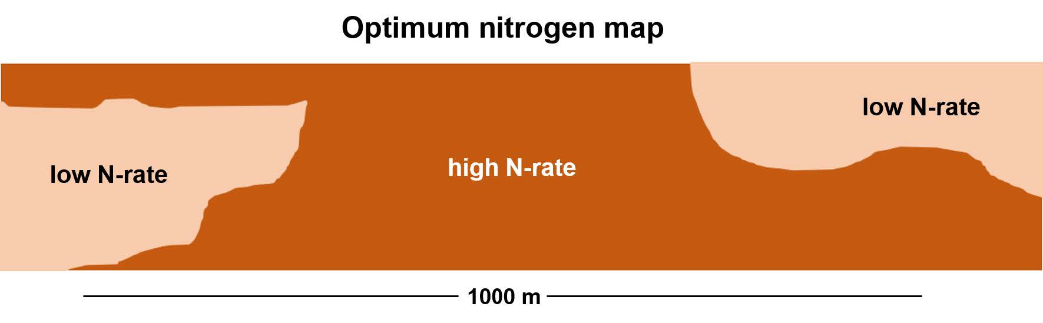
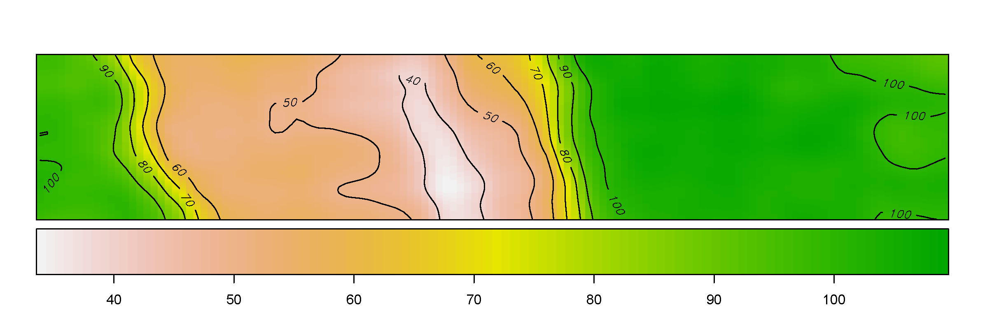
Mains: optimal treatment map

Slide 7

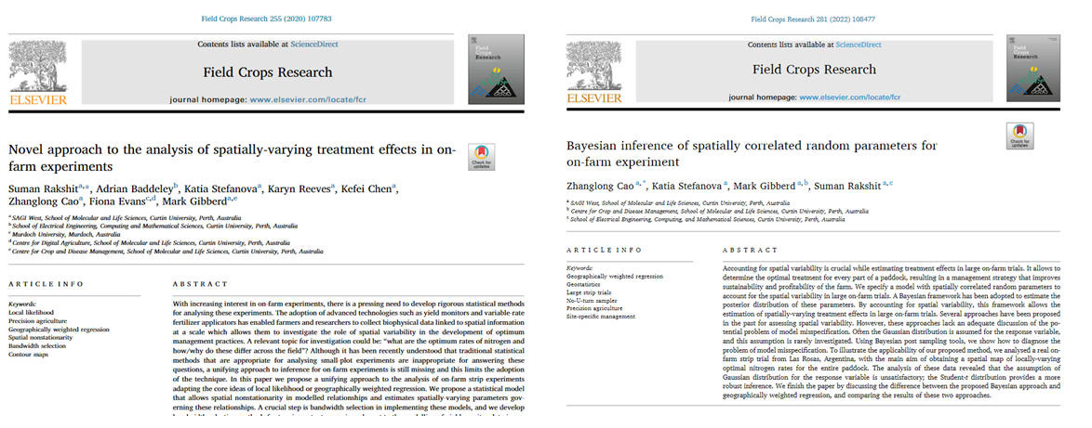
Menu: publications

Slide 8

Customer review: why do you use a systematic design?
Notes:
Where is the desserts?

Slide 9

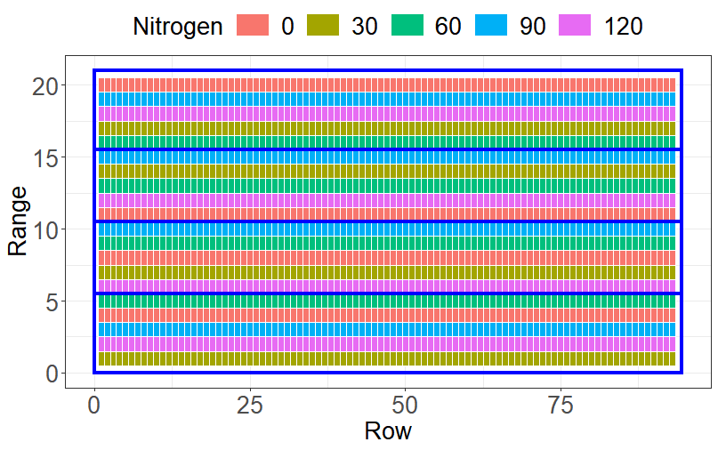
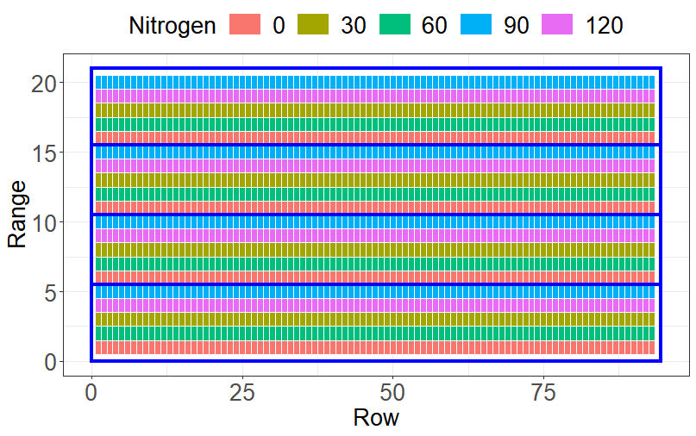
Desserts
A randomised design
A systematic design
5 treatments, 4 replicates, 93 rows × 20 ranges.

Slide 10

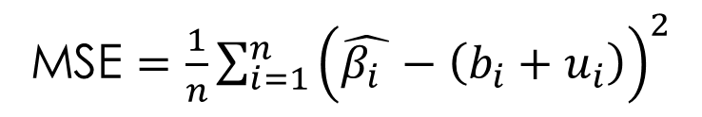
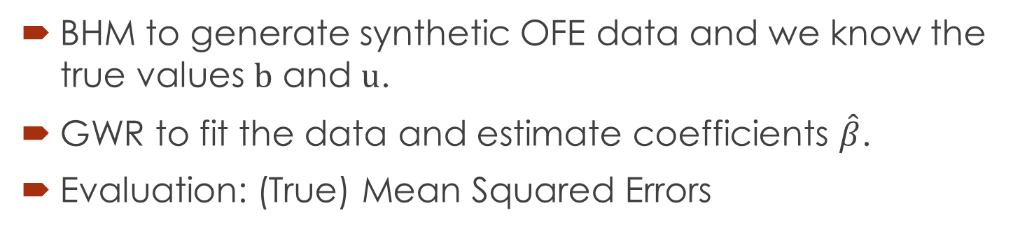
Recipe
BHM to generate synthetic OFE data and we know the true values $b$ and $u$.
GWR to fit the data and estimate coefficients $\hat{β}$.
Evaluation: (True) Mean Squared Errors
MSE $=\frac{1}{n}\sum_{i=1}^{n}{{\left(\hat{β_{i} }−\left(b_{i}+u_{i}\right)\right)}^{2}}$

Slide 11

Ingredients: bandwidth
pre-defined (5,9) and optimal (AICc).
Rep 1 |  |  |  |  | Rep 2
A | B | C | D | E | A | B | C | D | E
A | B | C | D | E | A | B | C | D | E
A | B | C | D | E | A | B | C | D | E
A | B | C | D | E | A | B | C | D | E
A | B | C | D | E | A | B | C | D | E
A | B | C | D | E | A | B | C | D | E
A | B | C | D | E | A | B | C | D | E
Rep 1 |  |  |  |  | Rep 2
A | B | C | D | E | D | C | E | B | A
A | B | C | D | E | D | C | E | B | A
A | B | C | D | E | D | C | E | B | A
A | B | C | D | E | D | C | E | B | A
A | B | C | D | E | D | C | E | B | A
… | … | … | … | … | … | … | … | … | …
… | … | … | … | … | … | … | … | … | …

Slide 12
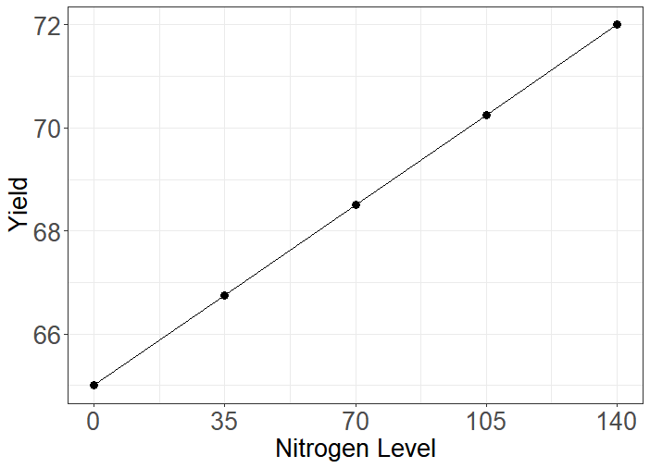
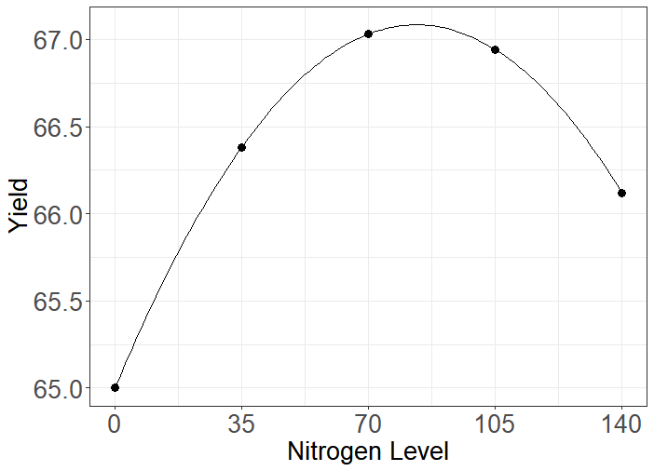
Ingredients: response

Slide 13


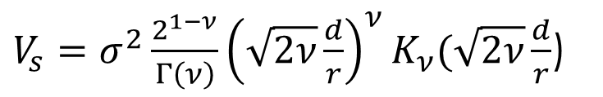
Ingredients: correlation
For the variance-covariance of
$u$,
$${V_{u}∼LKJcorr\left(ε\right), Σ}_{u}=V_{s}⊗V_{u}$$
$V_{s}=I$ , $V_{s}=$ AR1⊗AR1 and Matérn covariance
$V_{s}=σ^{2}\frac{2^{1−ν}}{Γ\left(ν\right)}{\left(\sqrt{2ν}\frac{d}{r}\right)}^{ν}K_{ν}(\sqrt{2ν}\frac{d}{r}$)

Slide 14

Let’s cook!
2 designs ×
3 bandwidths ×
2 response assumptions ×
2 correlation intensities ×
3 spatial covariance

Slide 15

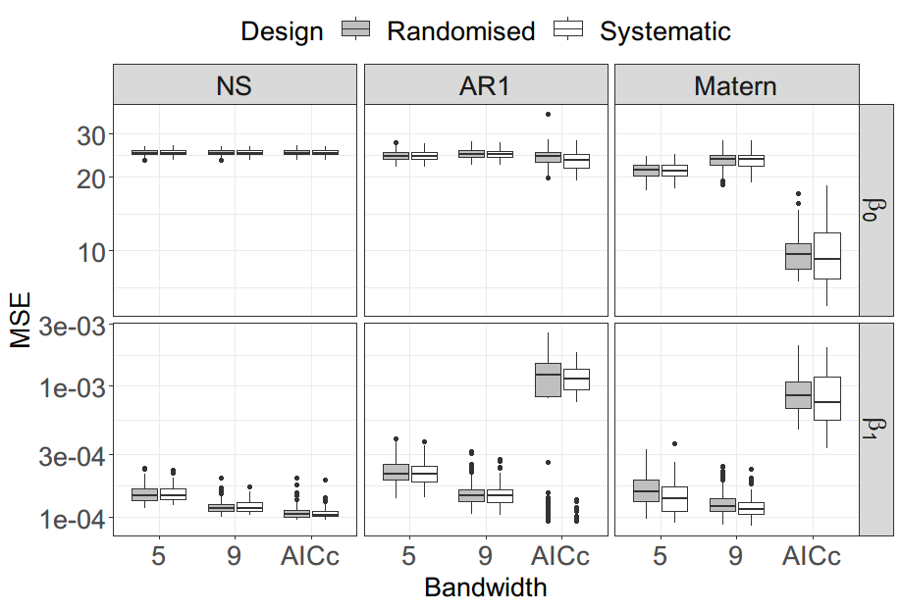
Results (low correlation)

Slide 16
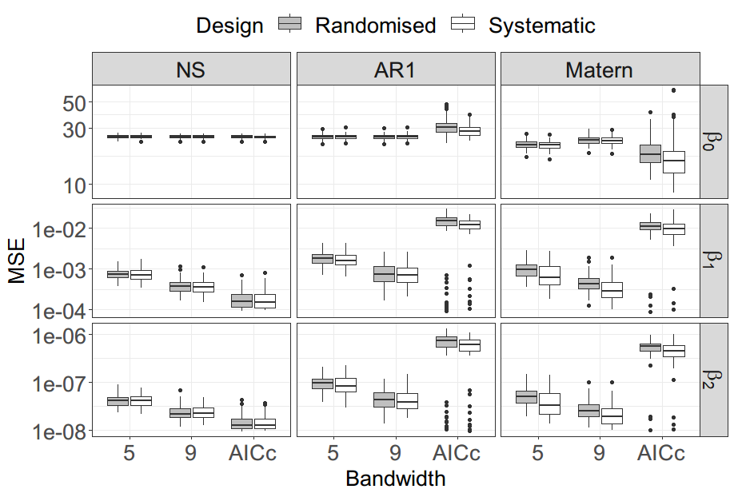
Results (low correlation)

Slide 17
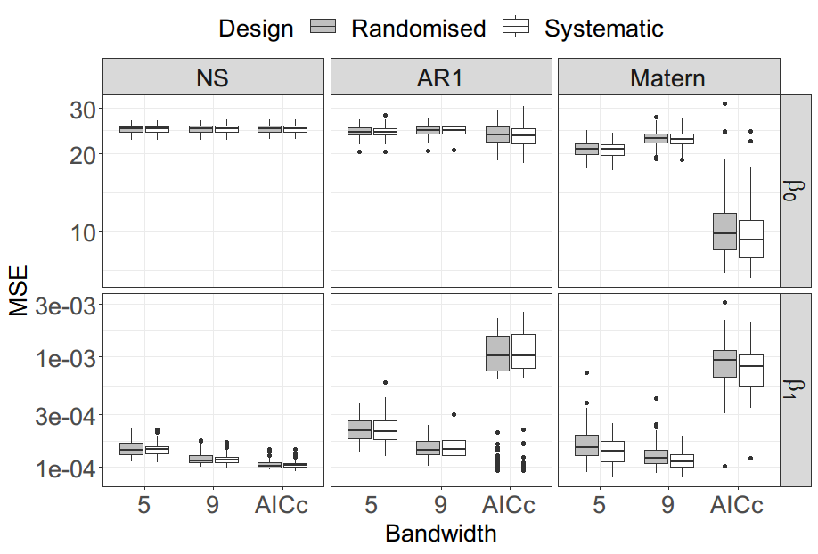
Results (high correlation)

Slide 18
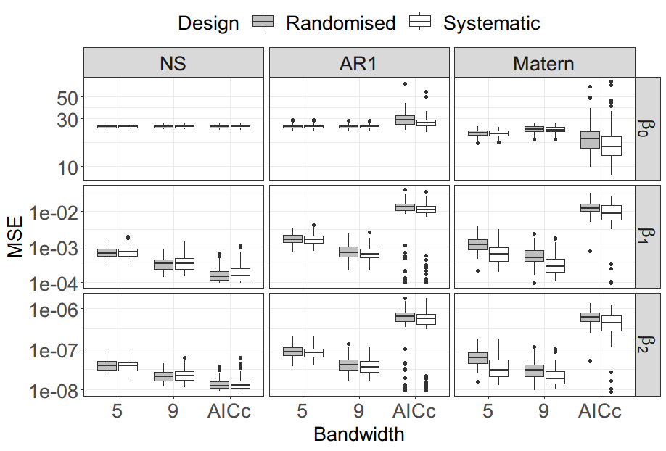
Results (high correlation)

Slide 19

Conclusion
A systematic design is superior to a randomized design for OFE when
spatial variation presents
a quadratic response is assumed
Additionally,
pre-defined bandwidth is better
GWR is able to capture the correlation
Notes:
Randomisation has been considered a crucial prerequisite for obtaining valid statistical inferences (H. P. Piepho, Möhring, and Williams (2013)).
However, in the application of precision agriculture (PA), a prescription map from the experimental results is required by the variable-rate applicators (VRA) before the start of the operation (Pringle, Cook, and McBratney (2004)).
The goal of OFE is to obtain a smooth map showing the optimal level of a controllable input, such as nitrogen rates, across a grid of rows and columns covering the whole field.

Slide 20
Cookbooks
Cao, Zhanglong, Katia Stefanova, Mark Gibberd, and Suman Rakshit. 2022. “Bayesian Inference of Spatially Correlated Random Parameters for on-Farm Experiment.” Field Crops Research 281 (May): 108477. https://doi.org/10.1016/j.fcr.2022.108477.
Fotheringham, A Stewart, Chris Brunsdon, and Martin Charlton. 2003. Geographically Weighted Regression: The Analysis of Spatially Varying Relationships. John Wiley & Sons.
Piepho, H. P., J. Möhring, and E. R. Williams. 2013. “Why Randomize Agricultural Experiments?” J. Agron. Crop Sci. 199 (5): 374–83. https://doi.org/10.1111/jac.12026.
Piepho, Hans-Peter, Christel Richter, Joachim Spilke, Karin Hartung, and Arndt Kunick. 2011. “Statistical Aspects of on-Farm Experimentation.” Crop & Pasture Science 62: 721–35. https://doi.org/10.1071/cp11175.
Pringle, M. J., S. E. Cook, and A. B. McBratney. 2004. “Field-Scale Experiments for Site-Specific Crop Management. Part I: Design Considerations.” Precision Agric 5 (6): 617–24. https://doi.org/10.1007/s11119-004-6346-1.
Rakshit, Suman, Adrian Baddeley, Katia Stefanova, Karyn Reeves, Kefei Chen, Zhanglong Cao, Fiona Evans, and Mark Gibberd. 2020. “Novel Approach to the Analysis of Spatially-Varying Treatment Effects in on-Farm Experiments.” Field Crops Research 255 (October 2019): 107783. https://doi.org/gg2vv7.

Slide 21

Thank you.
Notes:
Hope you enjoy the feast.

